Slide 1
LINUX DEVICE DRIVER
DAY 19 PPT
-SUBITHRA S

Slide 2
EXIT CMDS
exit(1): it indicates abnormal termination of a program perhaps as a result a minor problem in the code.
exit(2): it is similar to exit(1) but is displayed when the error occurred is a major one. this statement is rarely seen.
exit(127): it indicates command not found.
exit(132): it indicates that a program was aborted (received sigill), perhaps as a result of illegal instruction or that the binary is probably corrupt.
exit(133): it indicates that a program was aborted (received sigtrap), perhaps as a result of dividing an integer by zero.
exit(134): it indicates that a program was aborted (received sigabrt), perhaps as a result of a failed assertion.
exit(136): it indicates that a program was aborted (received sigfpe), perhaps as a result of floating point exception or integer overflow.
exit(137): it indicates that a program took up too much memory.
exit(138): it indicates that a program was aborted (received sigbus), perhaps as a result of unaligned memory access.
exit(139): it indicates segmentation fault which means that the program was trying to access a memory location not allocated to it.
this mostly occurs while using pointers or trying to access an out-of-bounds array index.
exit(158/152): it indicates that a program was aborted (received sigxcpu), perhaps as a result of cpu time limit exceeded.
exit(159/153): it indicates that a program was aborted (received sigxfsz), perhaps as a result of file size limit exceeded.

Slide 3
SIGNAL COMMANDS
sigsegv (signal 11 - segmentation fault):
sigsegv is a signal that indicates a segmentation violation, commonly known as a segmentation fault.
it occurs when a program attempts to access a memory location that it's not allowed to access, typically due to a bug like dereferencing a null pointer or accessing memory that has not been allocated.
when a segmentation fault occurs, the operating system sends the sigsegv signal to the process, causing it to terminate unless the signal is caught and handled by the program.
sigint (signal 2 - interrupt):
sigint is a signal sent to a process by its controlling terminal when a user presses the interrupt key (often ctrl+c).
by default, pressing ctrl+c in a terminal sends the sigint signal to the foreground process, which typically causes it to terminate.
programs can catch and handle the sigint signal to perform cleanup tasks or to implement custom behavior in response to an interrupt from the user.
.

Slide 4
SIGNAL COMMANDS
sigtstp (signal 18 - terminal stop):
sigtstp is a signal sent to a process by its controlling terminal when the user presses the suspend key (often ctrl+z).
unlike sigint, sigtstp typically suspends the process instead of terminating it. the process is placed into a suspended state and can be resumed later using the fg (foreground) or bg (background) commands.
programs can catch and handle the sigtstp signal to perform cleanup tasks or to implement custom behavior when the process is suspended.
sigusr1 (signal 10 - user-defined signal 1):
sigusr1 is a user-defined signal that can be used for application-specific purposes.
it is not assigned any specific default behavior by the operating system, so its meaning and usage are determined by the application.
developers can catch and handle the sigusr1 signal to implement custom behavior or to trigger specific actions within their programs

Slide 5
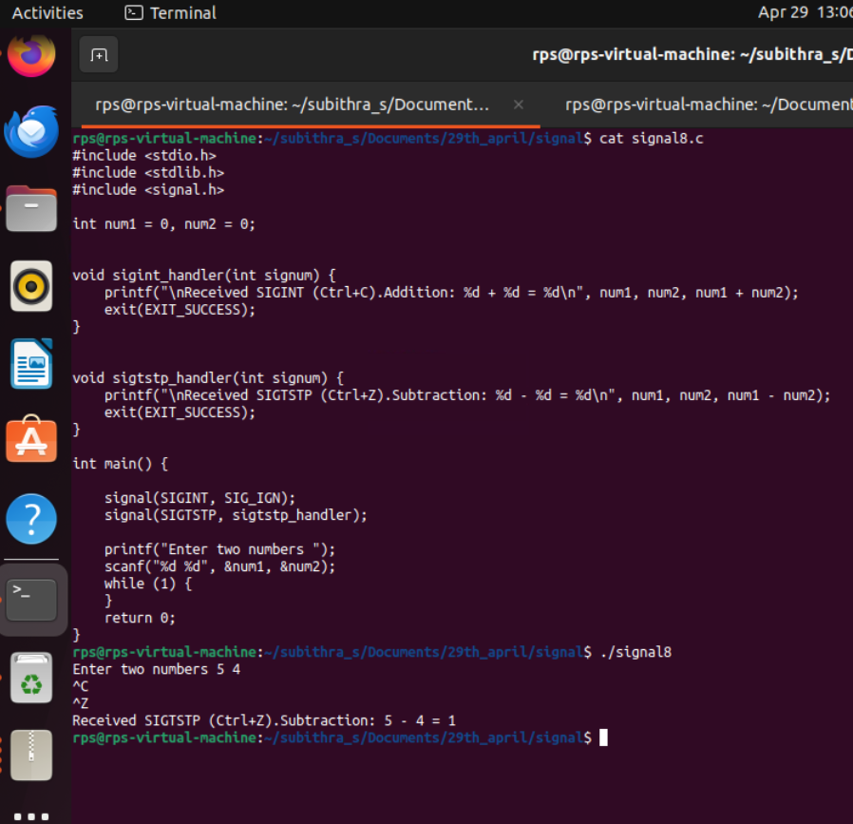
Signal commands with sigint,sigtstp,SIG_IGN

Slide 6
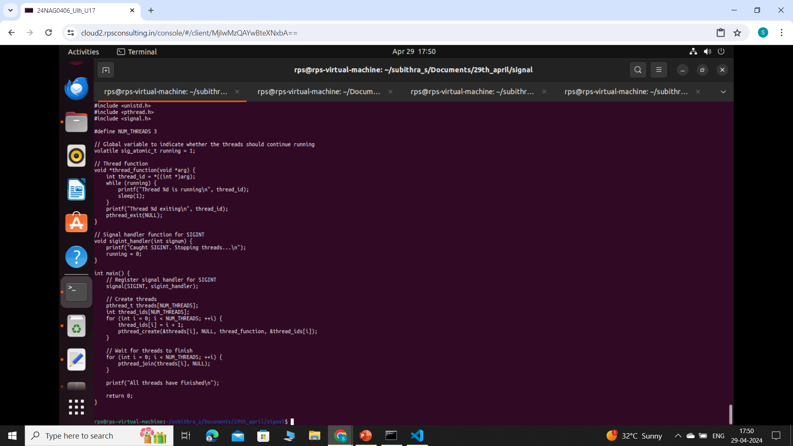
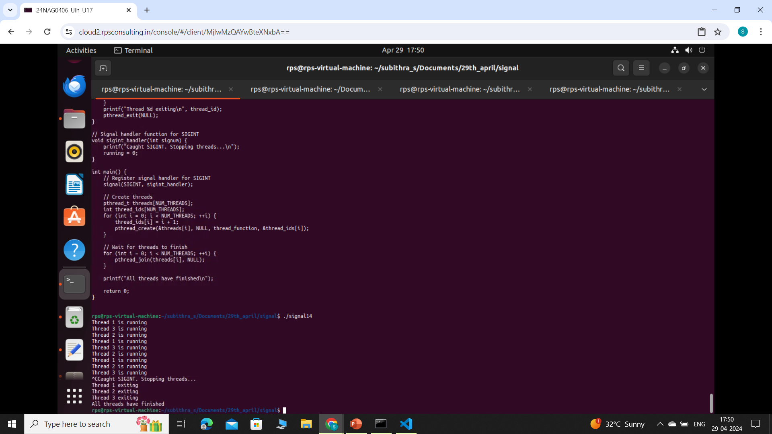
Signal commands in pthread

Slide 7
THANK YOU

